Slide 1
Message Integrity and SHA-512

Slide 2
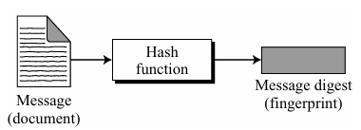
Message Integrity

Slide 3
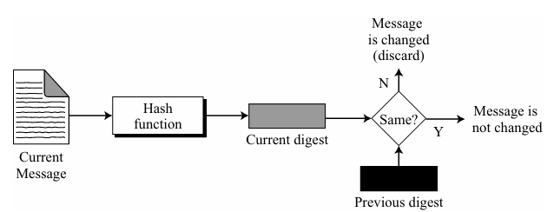
Message Integrity Checking

Slide 4
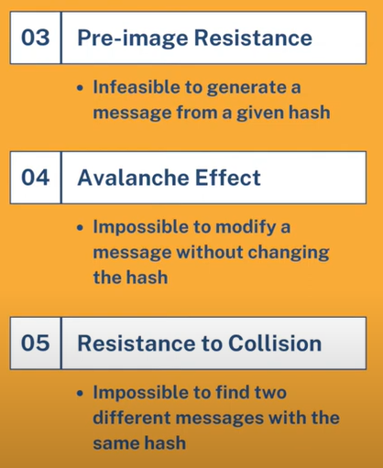
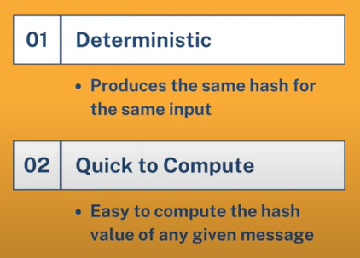
Properties of Message Digest

Slide 5
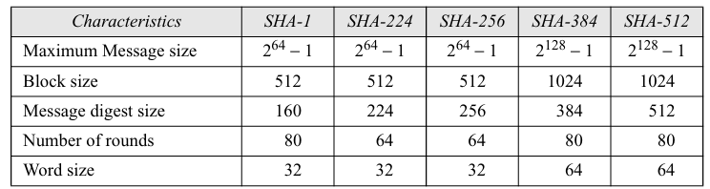
Secure Hash Algorithm (SHA)
Developed by National Institute of Standards and Technology (NIST)

Slide 6
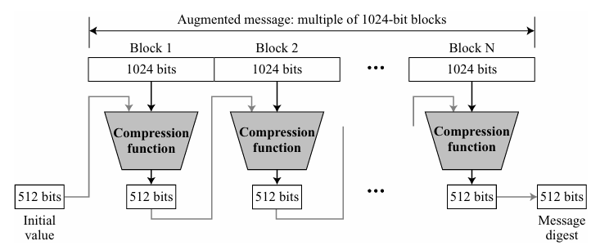
SHA-512 Algorithm (Block Diagram)

Slide 7
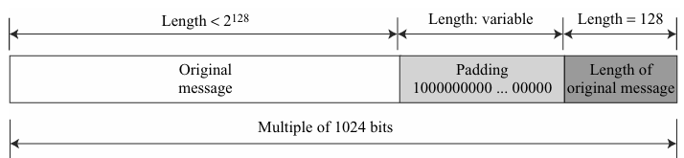
Padding and length field in SHA-512
(|M| + |P| + 128) = 0 mod 1024 → |P| = (− |M| − 128) mod 1024

Slide 8
Example for Padding
What is the number of padding bits if the length of the original message is 2590 bits?
|P| = (− 2590 −128) mod 1024 = −2718 mod 1024 = 354
So, the padding consists of one 1 followed by 353 0’s.

Slide 9
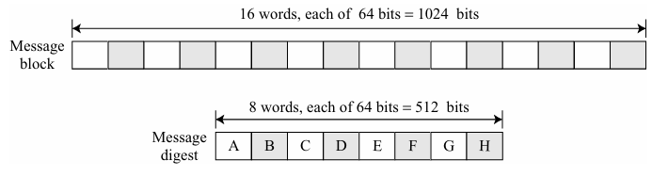
SHA-512 Words
SHA-512 operates on words.

Slide 10
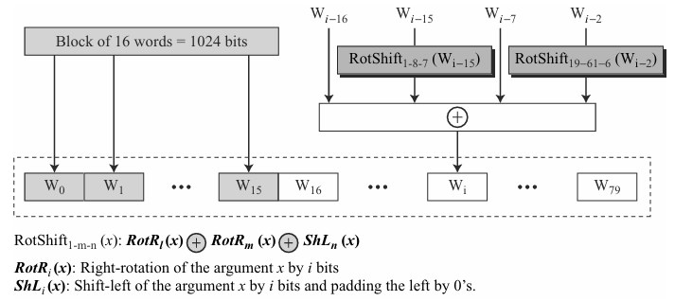
Word Expansion in SHA-512
16-word message block needs to be expanded to 80 words, from W₀ to W₇₉.
The 1024-bit block becomes the first 16 words.
Rest of the words come from already-made words according to the operation shown.

Slide 11
Example for Word Expansion in SHA-512
Show how W₆₀ is made.
W₆₀ = W₄₄ ⊕ RotShift₁₋₈₋₇ (W₄₅) ⊕ W₅₃ ⊕ RotShift₁₉₋₆₁₋₆ (W₅₈)

Slide 12
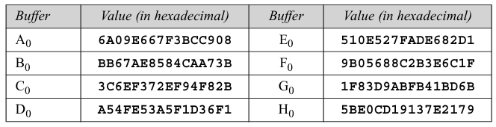
Initial Message Digest in SHA-512
From square root of first 8 primes

Slide 13
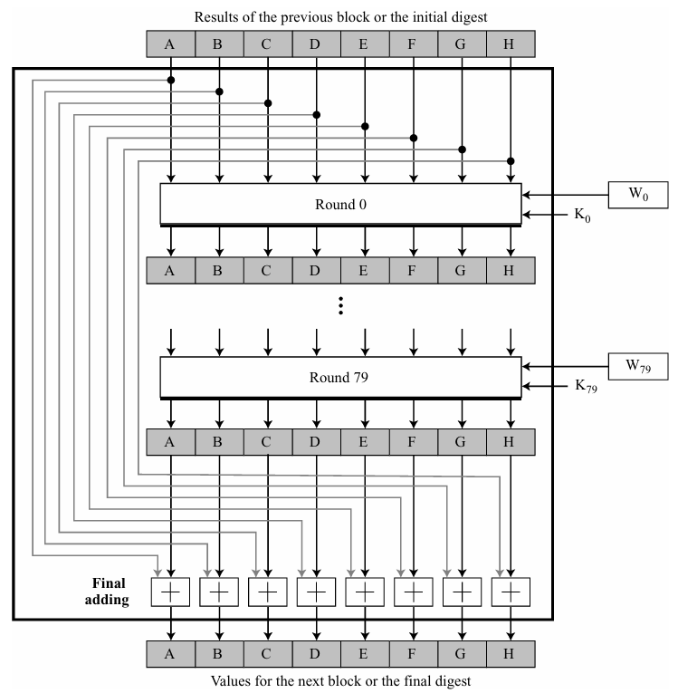
SHA-512 Compression Function

Slide 14
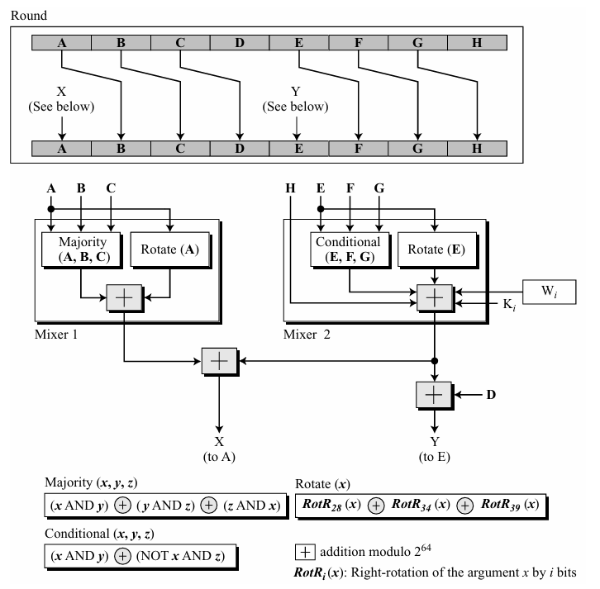
Structure of each round in SHA-512
Majority is the majority of three bits. If two or three bits are 1’s, the resulting bit is 1; otherwise it is 0.
Conditional function follows the logic
“If Ej then Fj; else Gj”.

Slide 15
Majority Function Example
Apply the Majority function on buffers A, B, and C. If the leftmost hexadecimal digits of these buffers are 0x7, 0xA, and 0xE respectively, what is the leftmost digit of the result?
The leftmost digits in binary are 0111, 1010, and 1110.
a. The first bits are 0, 1, and 1. The majority is 1.
It can also be proved using the definition of the Majority function:
(0 AND 1) ⊕ (1 AND 1) ⊕ (1 AND 0) = 0 ⊕ 1
b. The second bits are 1, 0, and 1. The majority is 1.
c. The third bits are 1, 1, and 1. The majority is 1.
d. The fourth bits are 1, 0, and 0. The majority is 0.
So, the result is 1110, or 0xE in hexadecimal.

Slide 16
Conditional Function Example
Apply the Conditional function on E, F, and G buffers. If the leftmost hexadecimal digits of these buffers are 0x9, 0xA, and 0xF respectively, what is the leftmost digit of the result?
The digits in binary are 1001, 1010, and 1111.
a. The first bits are 1, 1, and 1. Since E₁ = 1, the result is F₁, which is 1.
It can also be proved using the definition of the Condition function.
(1 AND 1) ⊕ (NOT 1 AND 1) = 1 ⊕ 0 = 1
b. The second bits are 0, 0, and 1. Since E₂ = 0, the result is G₂, which is 1.
c. The third bits are 0, 1, and 1. Since E₃ = 0, the result is G₃, which is 1.
d. The fourth bits are 1, 0, and 1. Since E₄ = 1, the result is F₄, which is 0.
So, the result is 1110, or 0xE in hexadecimal.

Slide 17
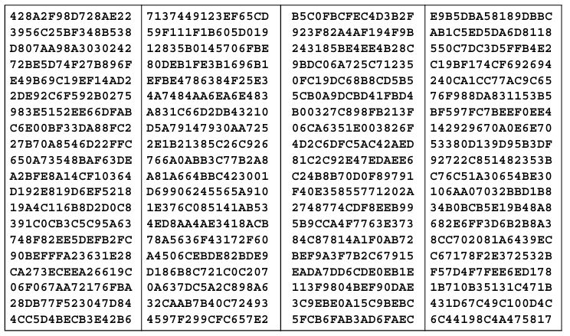
80 K_{i}’s used for 80 Rounds in SHA-512
From cubic root of first 80 primes (2,3, …. , 409)

